Slide 1
2018-2019
“8. SINIFLAR”
MASTERMIND
UNIT 2
TEEN LIFE
wopenglish GURURLA SUNAR…
https://wopenglish.com/ – wopenglish@gmail.com

Slide 4
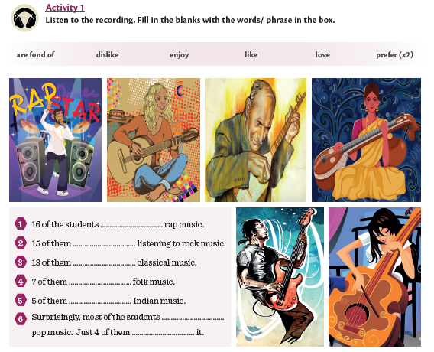
PREFER
ENJOY
LOVE
LIKE
ARE FOND OF
DISLIKE
PREFER

Slide 5
POCKET KNIFE
MAP
SLEEPING BAG
RELAX
EQUIPMENT
TENT
TORCH
CAMP FIRE
BACK PACK
COMPASS

Slide 6
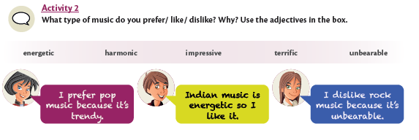

Slide 7
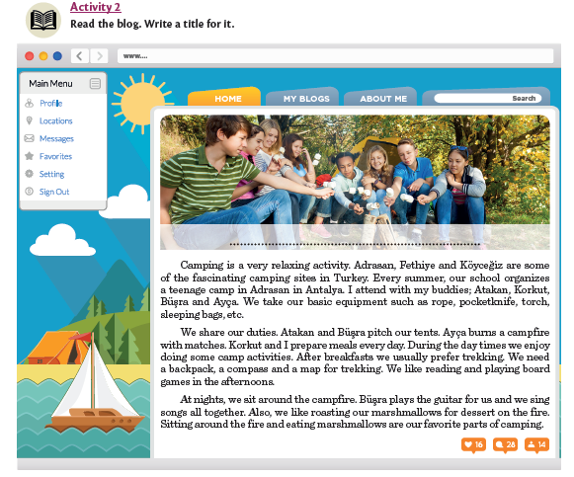
ACTIVITY 3

Slide 8
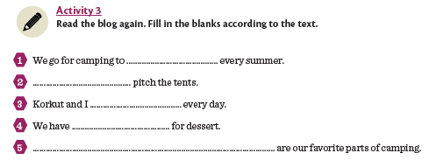
TEXT
RELAX
ATAKAN AND BUŞRA
PREPARE MEALS
ROASTED MARSHMALLOWS
SITTING AROUND THE FIRE AND EATING MARSHMALLOWS

Slide 9
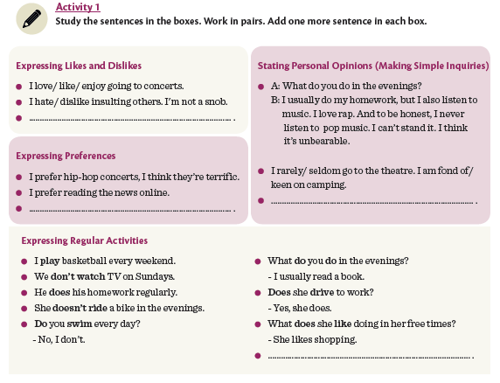

Slide 11
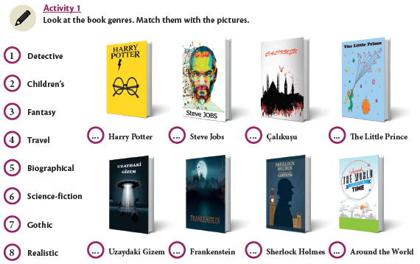
3
5
8
2
6
7
1
4

Slide 12
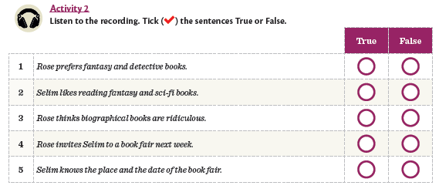
BIOGRAPHICAL
UNBEARABLE
SELİM INVITES

Slide 14
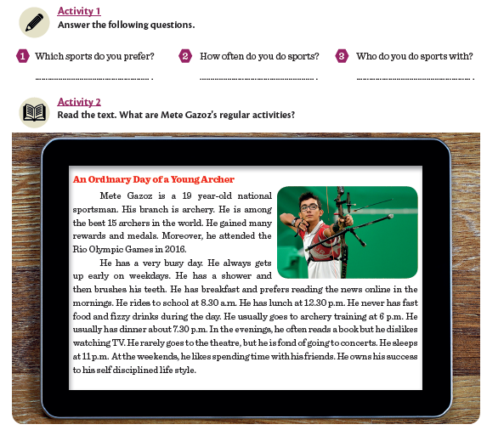
ACTIVITY 14

Slide 15
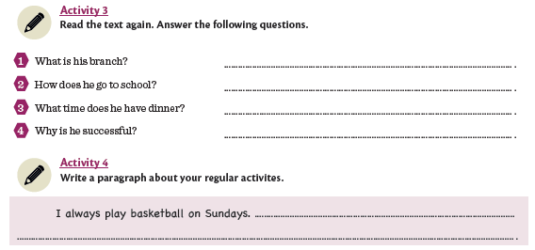
TEXT
ARCHERY
HE RIDES TO SCHOOL
HE HAS DINNER AT ABOUT 7.30
BECAUSE HE HAS A SELF DISCIPLINED LIFE

Slide 16
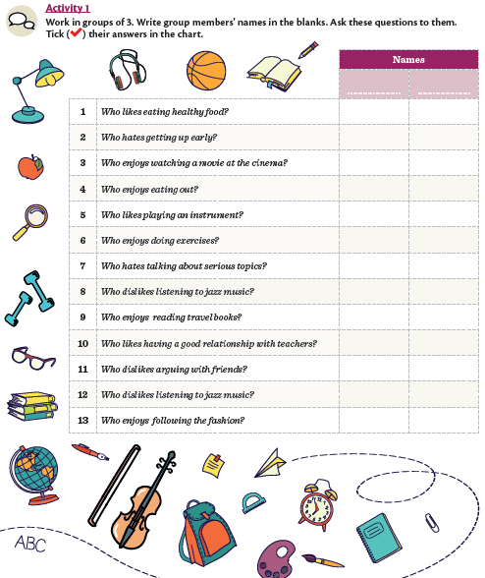

Slide 18
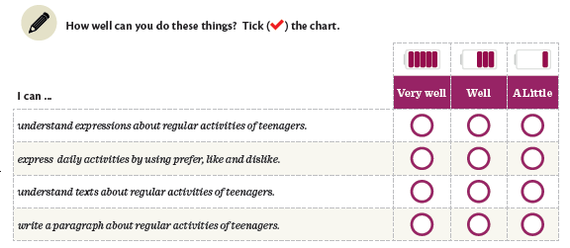

Slide 19
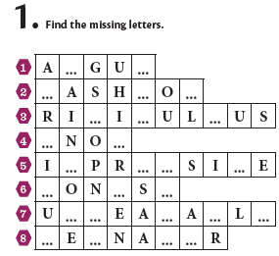
R
E
F
I
N
D
C
O
S
B
M
E
S
V
H
E
T
N
B
R
B
E
T
E
G
E

Slide 20
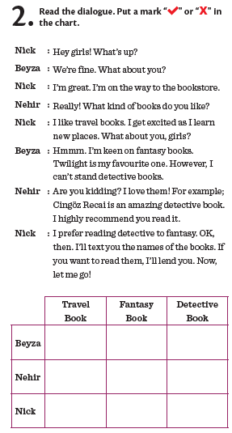

Slide 21
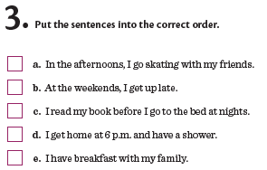
3
1
5
4
2

Slide 22
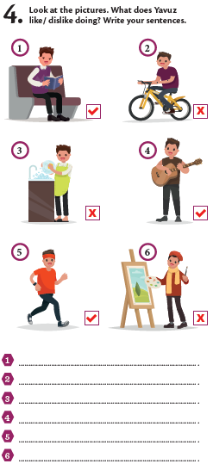
HE LIKES READING BOOKS
HE DOESN’T LIKE RIDING
HE DOESN’T LIKE WASHING THE DISHES
HE LIKES PLAYING GUITAR
HE LIKES TRACKING
HE DOESN’T LIKE MAKING PAINTINGS

Slide 23
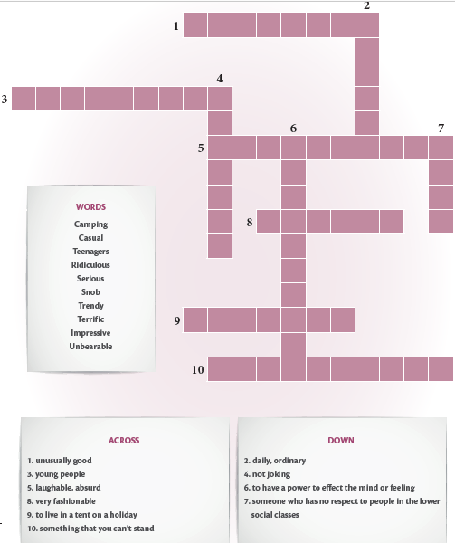
T E R R I F I C
A
S
U
A
L
T E E N A G E R S
E
R
I
O
U
S
I D I C U L O U S
M
P
R
E
S
S
I
V
E
N
O
B
T E N D Y
C A M P N G
U N B A R A B L E

Slide 24
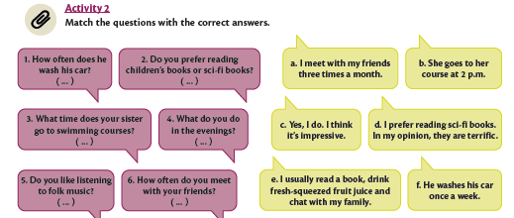
(F)
(D)
(B)
(E)
(C)
(A)

Slide 25
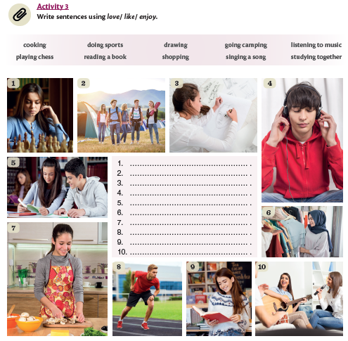
I LIKE PLAYING CHESS
I LIKE GOING CAMPING
I LIKE DRAWING PICTURES
I LIKE LISTENNING TO MUSIC
I LIKE STUDYING TOGETHER
I LIKE SHOPPING
I LIKE PLAYING COOKING
I LIKE DOING SPORTS
I LIKE READING BOOKS
I LIKE PLAYING GUITAR

Slide 26
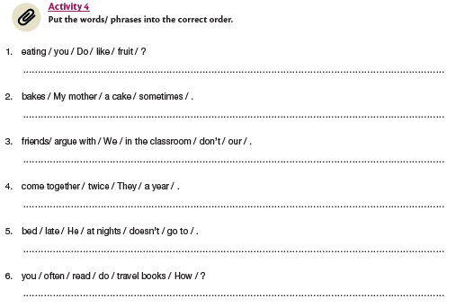
DO YOU LIKE EATING FRUIT ?
MY MOTHER SOMETIMES BAKES A CAKE.
WE DON’T ARGUE WITH OUR FRIENDS IN THE CLASSROOM
THEY COME TOGETHER TWICE A YEAR
HE DOESN’T GO TO BED LATE AT NIGHTS
DO YOU OFTEN READ TRAVEL BOOKS ?

Slide 27
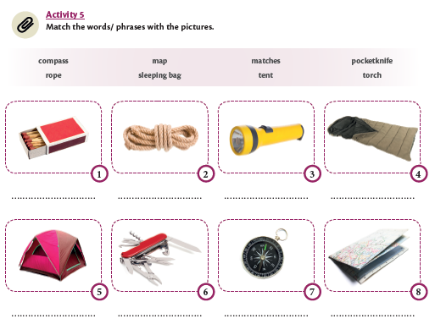
MATCHES
ROPE
TORCH
SLEEPING BAG
TENT
POCKET KNIFE
COMPASS
MAP

Slide 28
Wopenglish
sundu…
MASTERMIND
UNIT 2
TEEN LIFE
https://wopenglish.com/ – wopenglish@gmail.com
Her tür ve seviye İngilizce dersleriyle
İstanbul’da hizmetinizdeyiz.
Özel ders için sayfamızdan mesaj atın, dönüş yapalım.

