Slide 1
2018-2019
“8. SINIFLAR”
MASTERMIND
UNIT 4
On the phone
Wopenglish
GURURLA SUNAR…
https://wopenglish.com/ –wopenglish@gmail.com

Slide 3
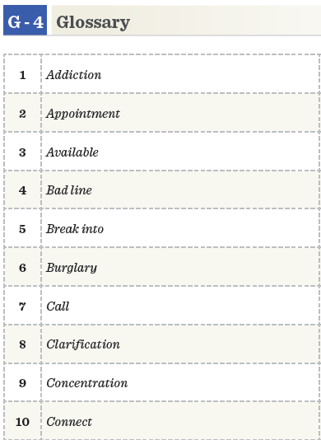
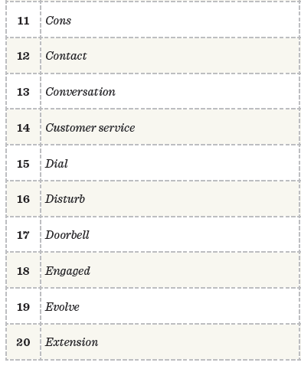
Dezavantaj
İlişki, bağlantı
Bağımlılık
Konuşma
Randevu
Bulur, hazır, burada
Müşteri hizmetleri
Numara çevirmek
Arızalı hat, cızırtılı bozuk hat
(Kapıyı) zolayarak bir yere girmek
Rahatsız etmek
Soygun
Kapı zili
Arama
Nişanlı
Açıklama, arıtma, aydınlatma
Geliştirmek, evrim geçirmek, yaymak
odaklanma
Dahili hat, uzatma
bağlanmak

Slide 4
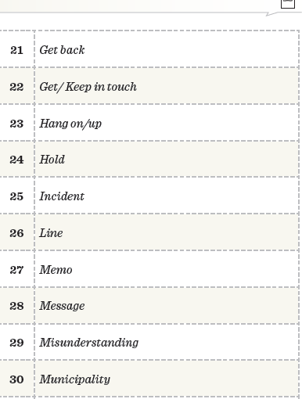
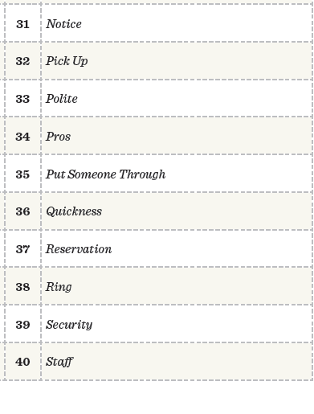
Farkına varmak, not
Geri dönmek
Ahizeyi kaldırmak, birini arabayla almak
Bağlantıda kalmak
Kibar
Telefonu kapamak
Avantaj
Tutmak,kaldırmak
Telefonu bağlamak
Olay
Hız, sürat, çabukluk
Telefon hattı
Yer ayırtma
Hafıza
Zil çalmak
Mesaj
Güvenlik
Yanlış anlama
Memur, çalışan
Belediye

Slide 5
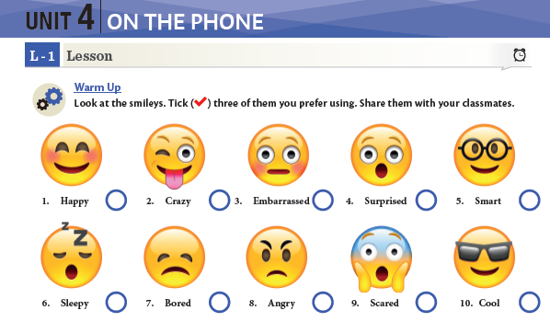

Slide 6
Alexandra lives Antalya
Faculty of law
And polite
wonders
Next Saturday evening

Slide 7
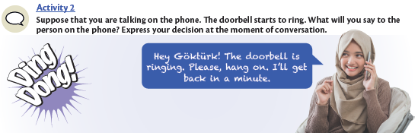
A: Hello, Fehim is speaking./This is Fehim
Who is speaking/ Who am I speaking to?
B: This is Zeliha. /Zeliha speaking
A: Zeliha, Is Ahmet available in the office?
B: No, he is out now.
A: Ok, I will call back later. Please tell him I called.

Slide 8
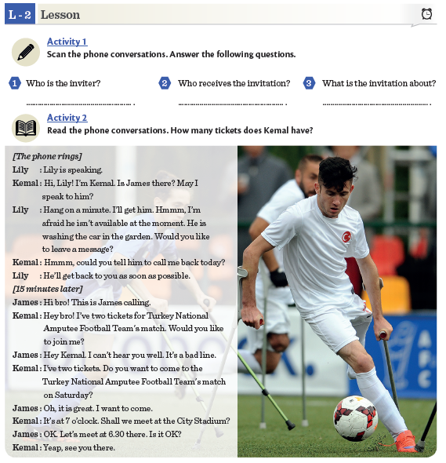
Kemal
James
About invitation the
Turkish Amputee Football
Team match

Slide 9
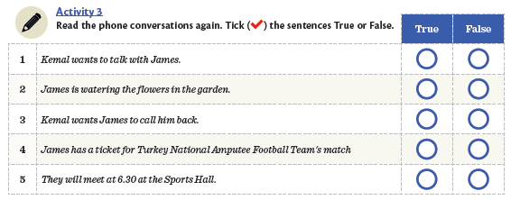

Slide 10
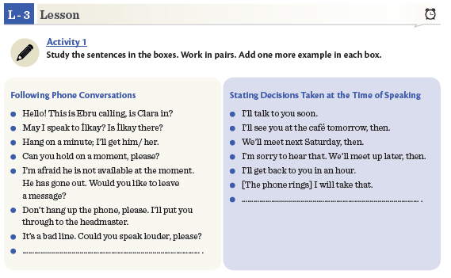
I will call him back.
Please ask him to call back

Slide 11
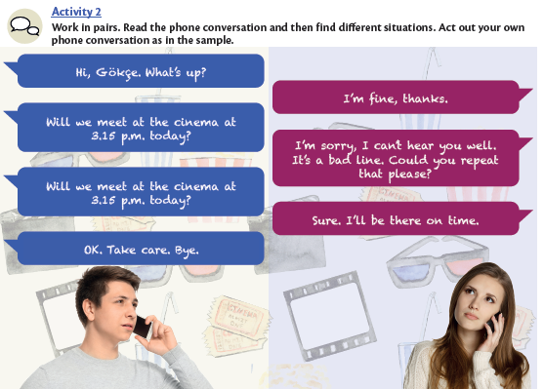
6
4
5
1
3
2

Slide 12
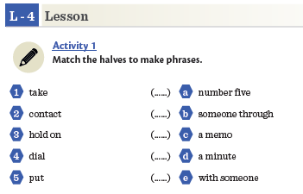
4
5
1
3
2

Slide 14
Hello, I am calling from Mado. Is Ahmet Gul there?
Yes, he is available. What was the issue?
I am calling for appointment
Clarification. Will you be here at 5 pm?
Surely, I will be there, may be a few minutes late, but I will.
Ok, see you then.

Slide 15
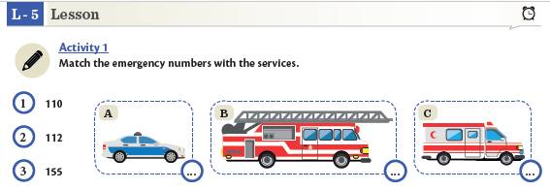

Slide 18
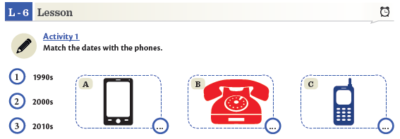

Slide 19
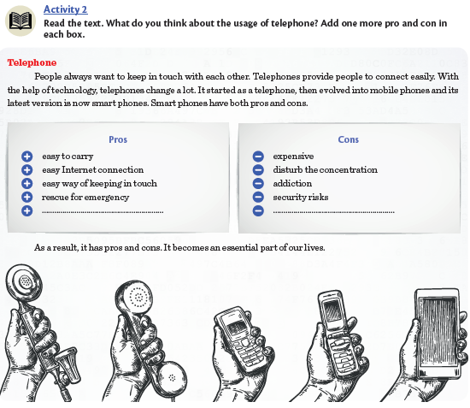
Shares video, photo and voice
Takes alot of time

Slide 21
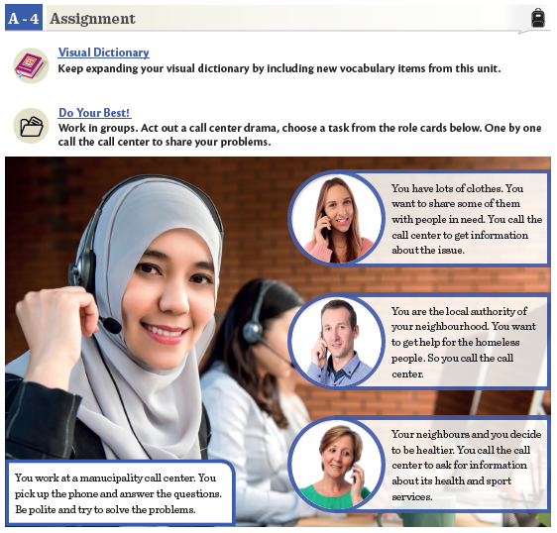

Slide 22
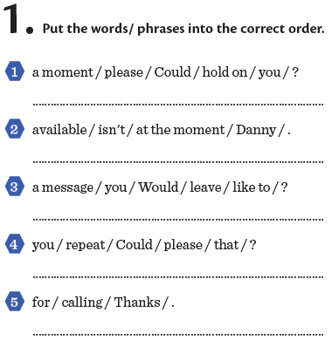
Could you hold on a minute, please?
Danny isn’t available at the moment?
Would you like to leave a message?
Could you repeat that , please?
Could you hold on a minute, please?

Slide 23
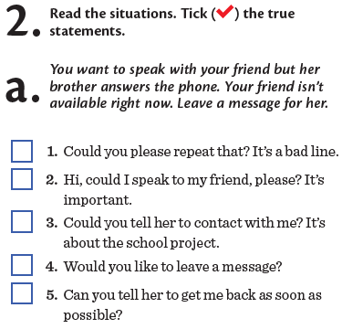
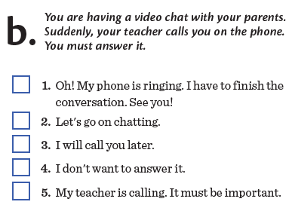

Slide 25
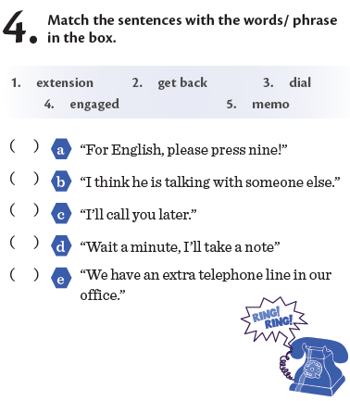

Slide 26
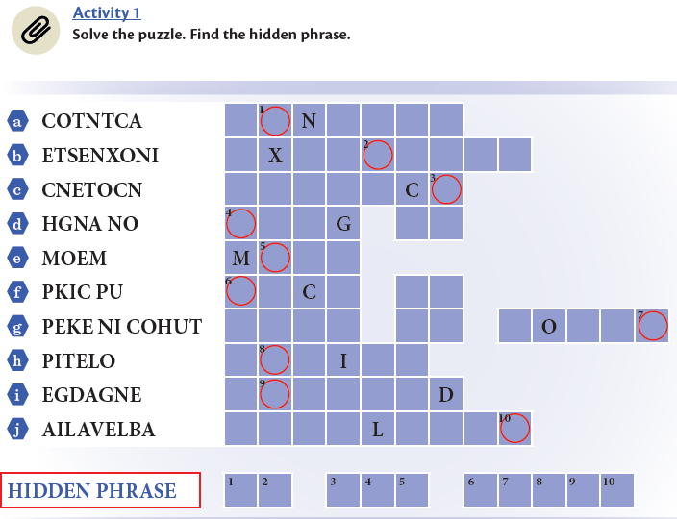
C O T A C T
E T E N S I O N
C O N N E T
H A N O N
E M O
P I K U P
K E E P I N T U C H
P O L T E
E N G A G E
A V A I A B L E
O N T H E P H O N E

Slide 27
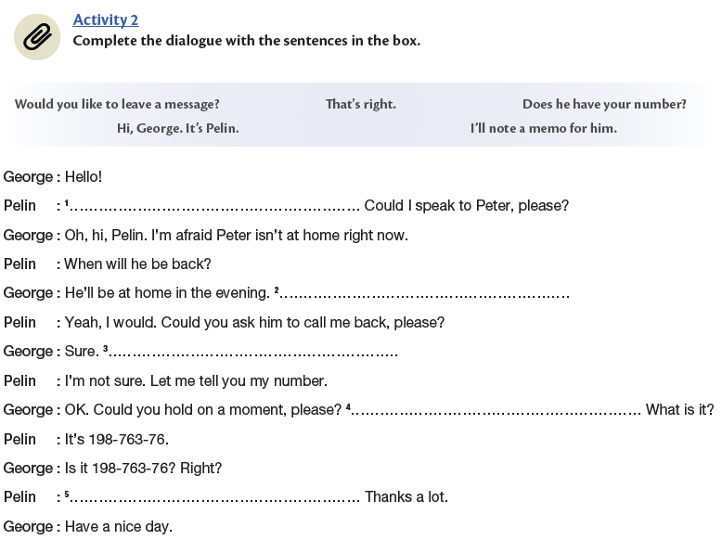

Slide 28
3
4
1
2

Slide 29
6
4
5
12
8
7
10
11
3
1
2
9

Slide 31
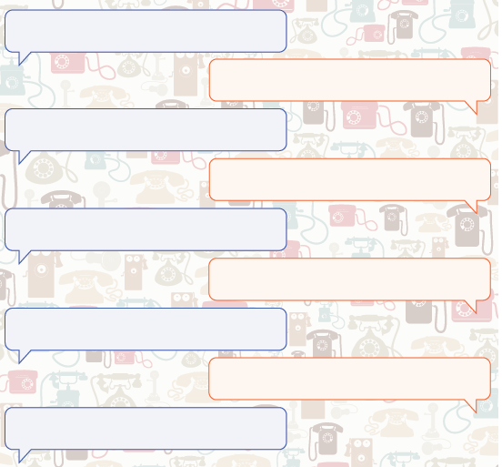
Hello, Ali speaking. Is Yavuz there?
Hi, Ali, Yavuz is speaking.
Hello, Yavuz. Do you have any plans for this evening?
Nothing much, I have no plans at all, actually.
I am going to Taksim Çiçek Pasajı to eat Kokorech.
Would you like to come?
I sounds a good idea. Let’s do it. When wil we go
there?
I think we will go on the 21st of November
at 7 pm.
Ok, see you then.
See you, bye…

Slide 32
Wopenglish
sundu…
MASTERMIND
UNIT 4
On the phone…
https://wopenglish.com/ – wopenglish@gmail.com
Her tür ve seviye İngilizce dersleriyle
İstanbul’da hizmetinizdeyiz.
Özel ders için sayfamızdan mesaj atın, dönüş yapalım.

