Slide 1
2018-2019
“8. SINIFLAR”
MASTERMIND
UNIT 6
The Adventures
wopenglish GURURLA SUNAR…
https://wopenglish.com/ –wopenglish@gmail.com

Slide 3
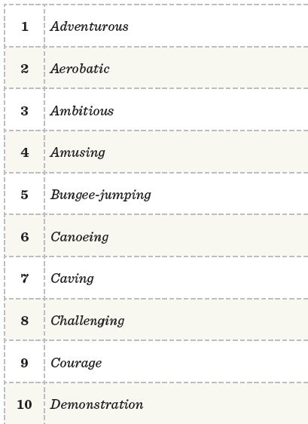
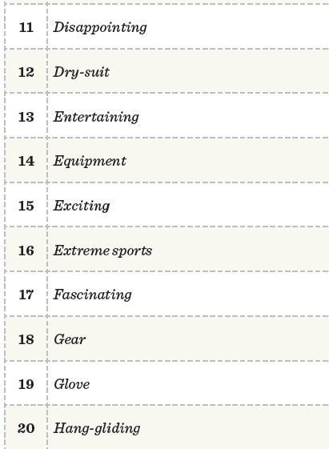
Macereperest
Hayal kırıklığına uğratıcı
Hava akrobasisi
Dalış giysisi
Hırslı , tukulu
Eğlendirici
Gülünç, komik
Ekipman, alet
Yüksekten ip ve yay sistemli
bir aparatla atlma sporu
Heyecan verici
Kano yapma
Adranalin sporları
Mağara keşif sporu
Büyüleyici
Meydan okuma ve
mücadele gerektiren
Vites
Cesaret
Eldiven
Şov, gösteri
Planörcülük, motorlu veya
motorsuz paraşit ile uçuş

Slide 4
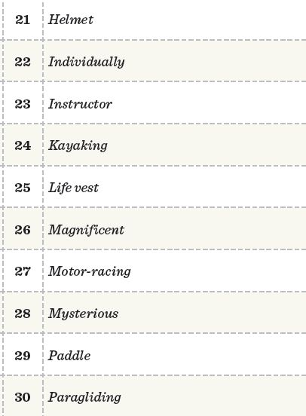
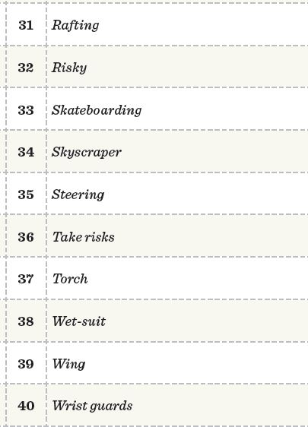
Kask
Şişme botla çoklu akarasu
mücadele sporu
Bireysel olarak
Riskli
Eğitmen
Kaykay yapmak
Kapalı sistem eskimo kayıkçılığı
Gökdelen
Can yeleği
Direksiyon, dümen (kullanmak)
Muhteşem
Risk almak
Motor yarışı
El feneri
Gizemli
Mayo
Çift taraflı kürek
Kanat
Planör , paraşüt
Bileklik

Slide 5
4
3
1
2

Slide 6
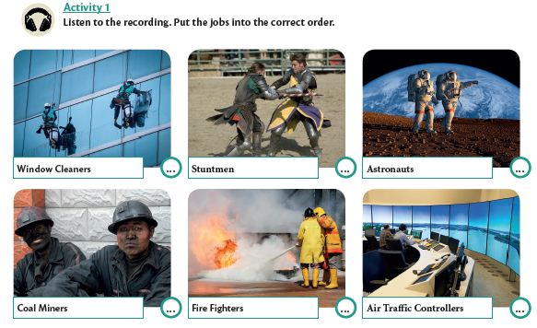
log in
6
4
1
5
3
2

Slide 7
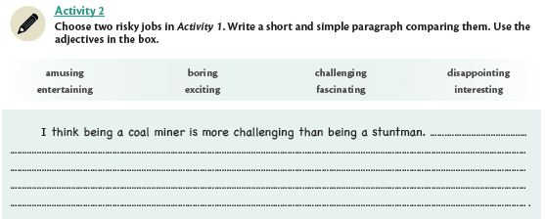
I think being an astronout is more exciting than a stuntman, because you hower up
in the space.

Slide 8
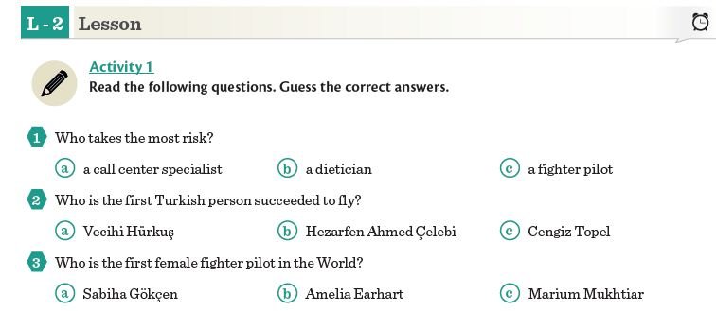

Slide 9
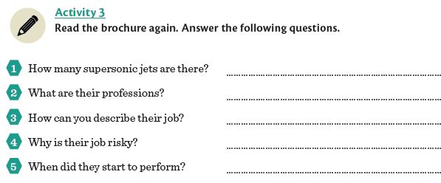
Squadron: Filo
Adventerous and brave
7 jets
They are pilots.
Their job is risky.
Because they do all manouvers manually
With a speed between 260-1000 kms
They started in 1992

Slide 10
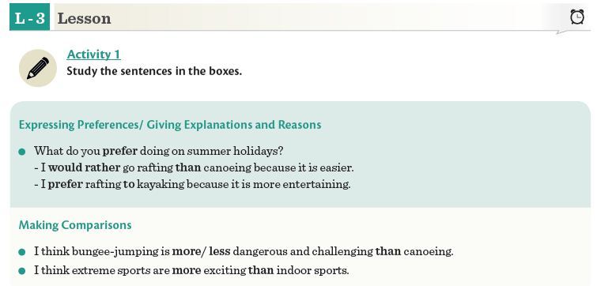

Slide 11
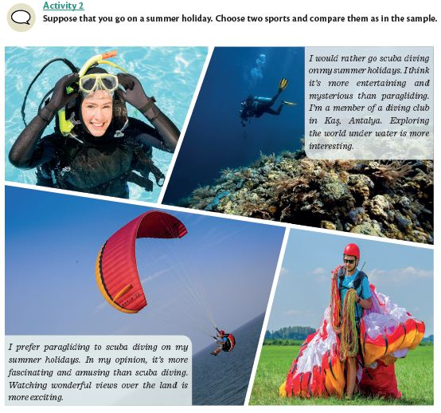

Slide 13
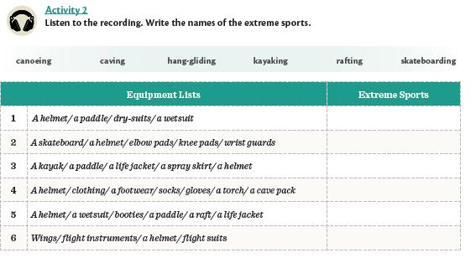
Sprey skirt:Su girişini engelleyen
eteğe benzeyen bir malzeme
Canoeing
Skateboarding
Kayaking
Caving
Rafting
Hang-gliding

Slide 15
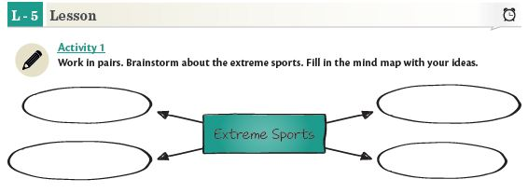
Sky
Diving
Caving
Hang-gliding
Paragliding

Slide 17
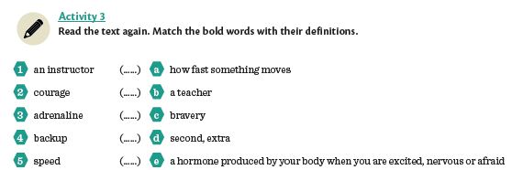
B
C
E
D
A

Slide 18
They were the pioneers of thir field.
They tried their activity for the first time.

Slide 19
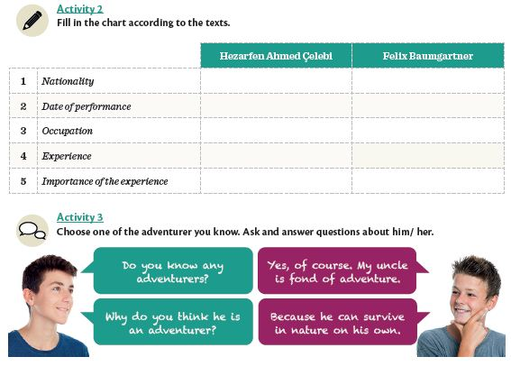
Turkish
Austrian
In 1632
In 2012
Scientist
Adventurer, skydiver
Flew with handmade wings
Freefall from space
improved aircraft industry
Scientific researches in space

Slide 20
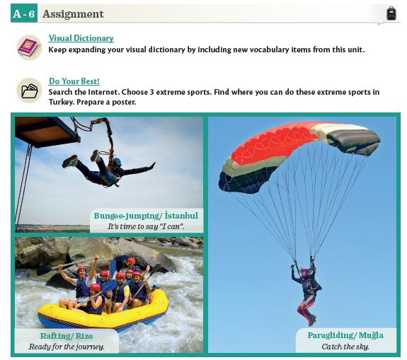

Slide 21
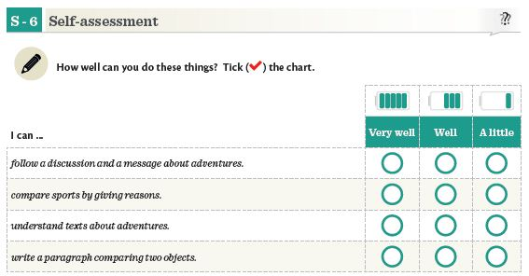

Slide 22
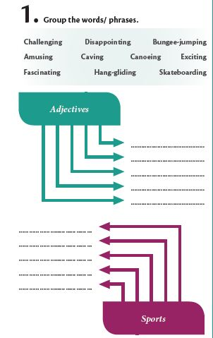
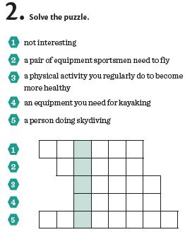
Challenging
Amusing
Fascinating
Disappointing
Exciti ng
Caving
B O R I N G
Hang-gliding
W I N G S
Bungee-jumping
Canoeing
S P O R T
Skateboarding
K A Y A K
S K Y D I V E R

Slide 23
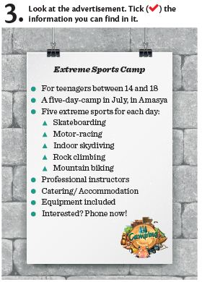
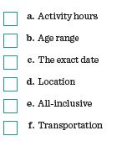

Slide 24
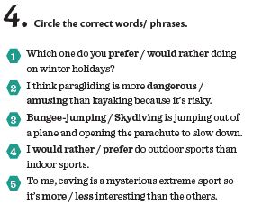

Slide 25
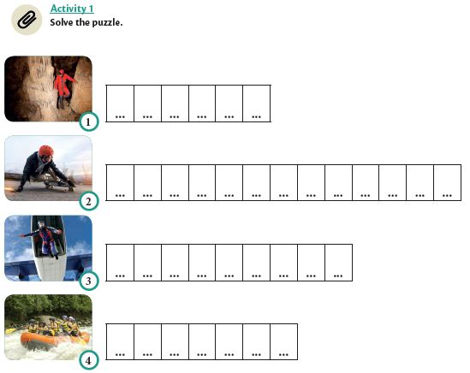
C A V I N G
S K A T E B O A R D I N G
S K Y D I V I N G
R A F T I N G

Slide 26
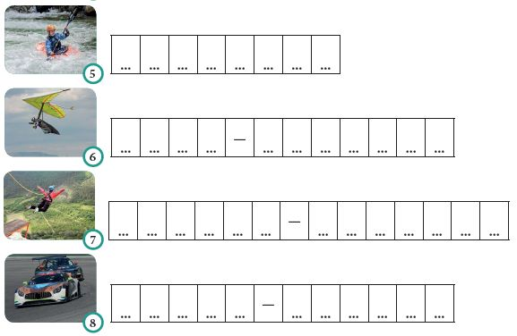
K A Y A K I N G
H A N G G L I D I N G
B U N G E E J U M P I N G
M O T O R R A C I N G

Slide 27
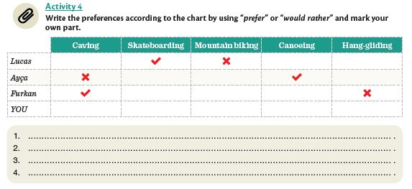
Lucas would rather do skateboarding moe than mountain biking
Ayça prefers canoeing more than caving
Ayça prefers caving to hang-gliding
I prefer mountain biking more than canoeing

Slide 28
Being a coal miner is more risky
Than being a farmer
Students’ own answers

Slide 29
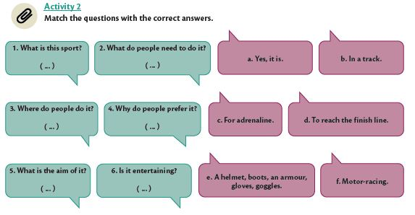
F
E
B
C
D
A

Slide 30
1
3
2
5
4
6

Slide 31
www.wopenglish sundu…
MASTERMIND
UNIT 6
The Adventures…
wopenglish GURURLA SUNAR…
https://wopenglish.com/ –wopenglish@gmail.com

